Slide 1
CIS 4296
Use Case Diagrams
Product Vision Statement

Slide 2
Use Case Diagrams
Use Case - All details about every possibility
Use Case Diagram – Higher level view of the system
“Blueprint” for your system – simple graphical representation of what the system must actually do
UML Tool
Demonstrates the different ways the users (actors) will interact with the system

Slide 3
Use Case Diagrams
Will help you discuss with your client
Scenarios in which your system or application interacts with people, organizations, or external systems
Goals that your system or application helps those entities (known as actors) achieve
The scope of your system
Ideal for…
Representing the goals of system-user interactions
Defining and organizing functional requirements in a system
Specifying the context and requirements of a system
Modeling the basic flow of events in a use case

Slide 4
Use Case Diagrams
Use case diagram— a UML model used to graphically show uses cases and their relationships to actors
Automation boundary— the boundary between the computerized portion of the application and the users who operate the application.
The system is the automation boundary – the system is not an actor.

Slide 5
Use Case Diagram Symbols and Notations
System boundary boxes: A box that sets a system scope to use cases. All use cases outside the box would be considered outside the scope of that system.
Actors: Stick figures that represent the people actually employing the use cases.
Use cases: Horizontally shaped ovals that represent the different uses that a user might have.
Associations: A line between actors and use cases. In complex diagrams, it is important to know which actors are associated with which use cases.

Slide 6
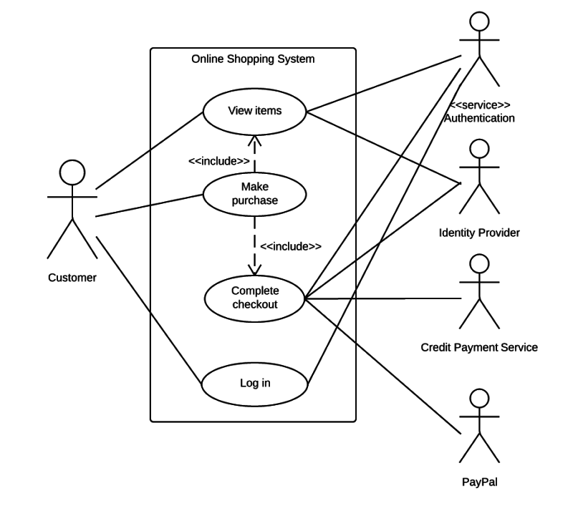

Slide 7
Defining Actors and Scenarios
Written from the ‘voice of the customer’
Actor – lives outside of the application but has a goal they want to accomplish within it. Person or external system that interacts with the system to achieve a user goal.
Human or system
A role
Primary vs Secondary
Scenario – Goal actor can accomplish in a single encounter
Focus on user’s goal
Develop iteratively

Slide 8
Use Case Diagram All actors and all use cases

Slide 9
Use Case Diagrams The <<Includes>> relationship
A relationship between use cases where one use case is included within the other use case— like a called subroutine.
Good way to show emails

Slide 10
Sample Diagram

Slide 11
To Learn More on Use Case Diagrams
https://www.youtube.com/watch?reload=9&v=zid-MVo7M-E

Slide 12
The Product Vision
A starting point for software product development is a ‘product vision’.
Product visions are simple statements that define the essence of the product to be developed.
A short impactful statement, short enough to be an elevator pitch.

Slide 13
The Product Vision
The product vision should answer three fundamental questions:
Who are the target customers and users?
What is the product to be developed?
Why should customers buy this product?

Slide 14
Moore’s template to develop a vision
FOR (target customer)
WHO (statement of the need or opportunity)
The (PRODUCT NAME) is a (product category)
THAT (key benefit, compelling reason to buy)
UNLIKE (primary competitive alternative)
OUR PRODUCT (statement of primary differentiation)

Slide 15
Vision template example
“FOR a mid-sized company’s marketing and sales departments
WHO need basic CRM functionality,
THE CRM-Innovator is a Web-based service
THAT provides sales tracking, lead generation, and sales representative support features that improve customer relationships at critical touch points.
UNLIKE other services or package software products,
OUR product provides very capable services at a moderate cost.”

Slide 16
Vision template example
For the OWLCard Office who replace lost and stolen Owl Cards
the RainbowPad is an iPad web-based service that allows students to fill forms and verify transactions
unlike the current paper-based system where forms are not organized our solution allows to store forms digitally and compile forms.

Slide 17
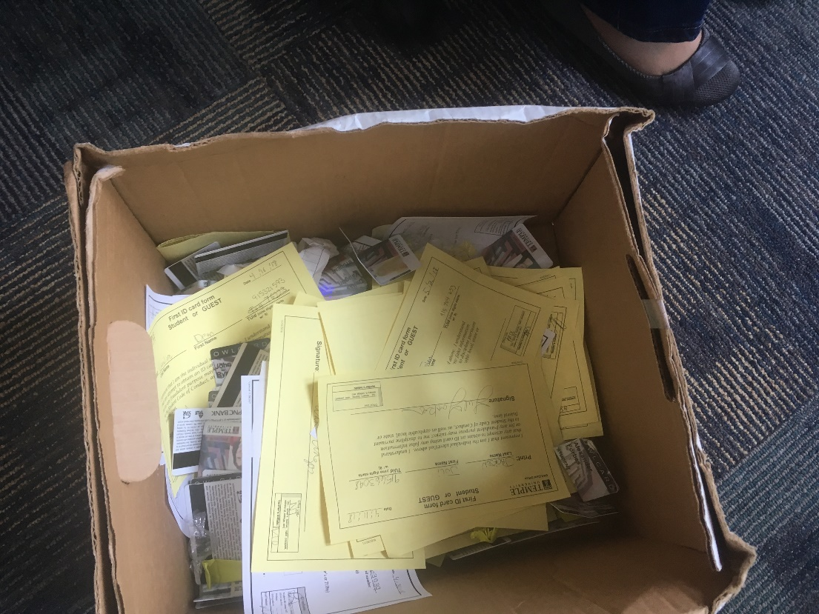
RainbowPad competitor

